Slide 1
Handling and Management of Dangerous Goods (DG) at industrial site in accordance to ADR regulation
Fatima Abdulla Al-Raisi
05.02.2020
Notes:
Hello everyone and good morning,
My name is Fatima Al-Raisi and today I’ll be talking about handling and Management od DG at industrial sites in accordance with ADR regulations
A little introduction on myself, I am an environmental systems coordinators at Qatar fertilizer company, with a degress in chemicals engineering from Texas A&M university .

Slide 2
Agenda
Introducing ADR Regulation
ADR Requirements
Implementation of ADR requirements
Implementation Outcomes
Closing and Discussion
Notes:
Let’s start by going over the agenda of the presentation, ill start first by introducing the ADR regulation briefly.
Then go over ‘the reason behind implementation at QAFCO
Furthermore, I’ll elaborate further on the specific elements of ADR by introducing the concept of each briefly and hand in hand highlight the outcomes of implementing each aspect of the regulation and close by summing up the main highlights and benefits of implementing such a mandate.

Slide 3
Introducing ADR Regulation
About ADR
The European Agreement Concerning the International Carriage of Dangerous Goods (DG) by Road.
Inaugurated on the 30th September 1957.
Mandated for implementation in 1968.
Implementation at QAFCO
Implementing a regulation issued by Mesaieed Industrial City (MIC)
Regulating the process of transporting Dangerous goods

Slide 4
ADR Requirements
1
Participants in Transport Activity
5
Vehicle Marking and Labelling
9
Documentation
13
Emergency Action
2
Training and Training Records
6
Tank Marking and Labelling
10
Transport Equipment Inspection and Certification
14
Authorization for transport of DG
3
DG Classification
7
Vehicle Safety Requirement
11
Security Provisions
15
Enforcement and Inspection
4
Packing, Marking, and Labeling
8
Loading and unloading
12
High Consequence DG
Notes:
Displayed here on this slide are the 15 requirements of ADR regulation as mandated by MIC, they cover a very wide a comprehensive scope that we will go over briefly for each of the elements.

Slide 5
Implementation of ADR requirements
Consigner
Carrier
Driver and Vehicle Crew
Packer
Filler
Loader
Unloader
Consignee
Participants' Safety Officer/Advisor
Participants in the Transport Activity
Roles, Responsibilities, mandates and trainings
Training and Training Records
General Awareness Training, Specific Training: Safety, Security, Driving, and etc.
Maintaining Training Records
Notes:
Starting off with the first element, which dives into the role definition, responsibility of all participants in the activity of transportation of DG, this is very key due to the criticality of each role.

Slide 6
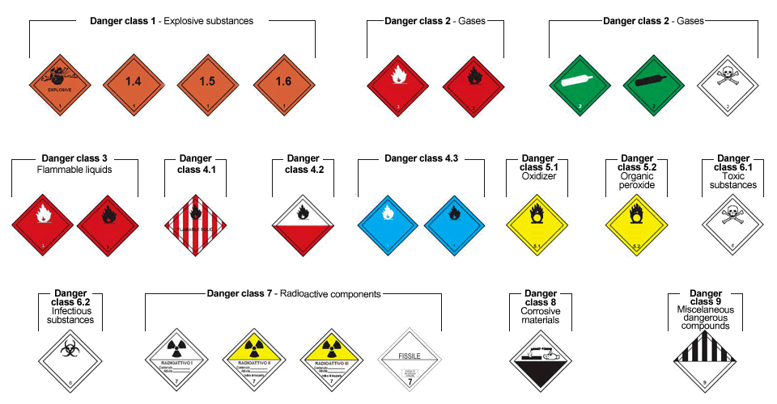
Implementation of ADR requirements
Dangerous Goods Labeling
Packing Group | Danger Level
I | High Danger
II | Medium Danger
III | Low Danger
Notes:
Going to the third requirement of the regulation, for every material transported, classification of the material . i.e. hazardous labeling is very important if not the most, because it shows the handler of the material

Slide 7
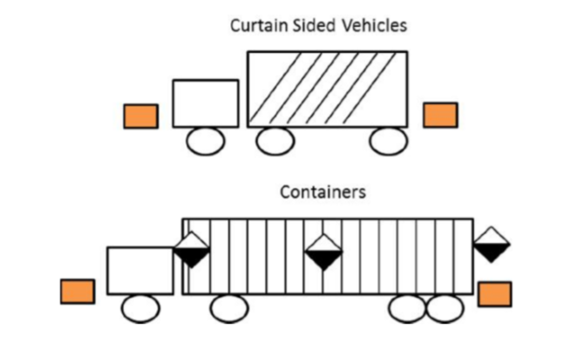
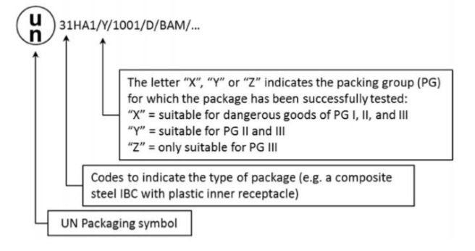
Implementation of ADR requirements
Packing, Marking and Labeling
Vehicle Marking and Labelling

Slide 8
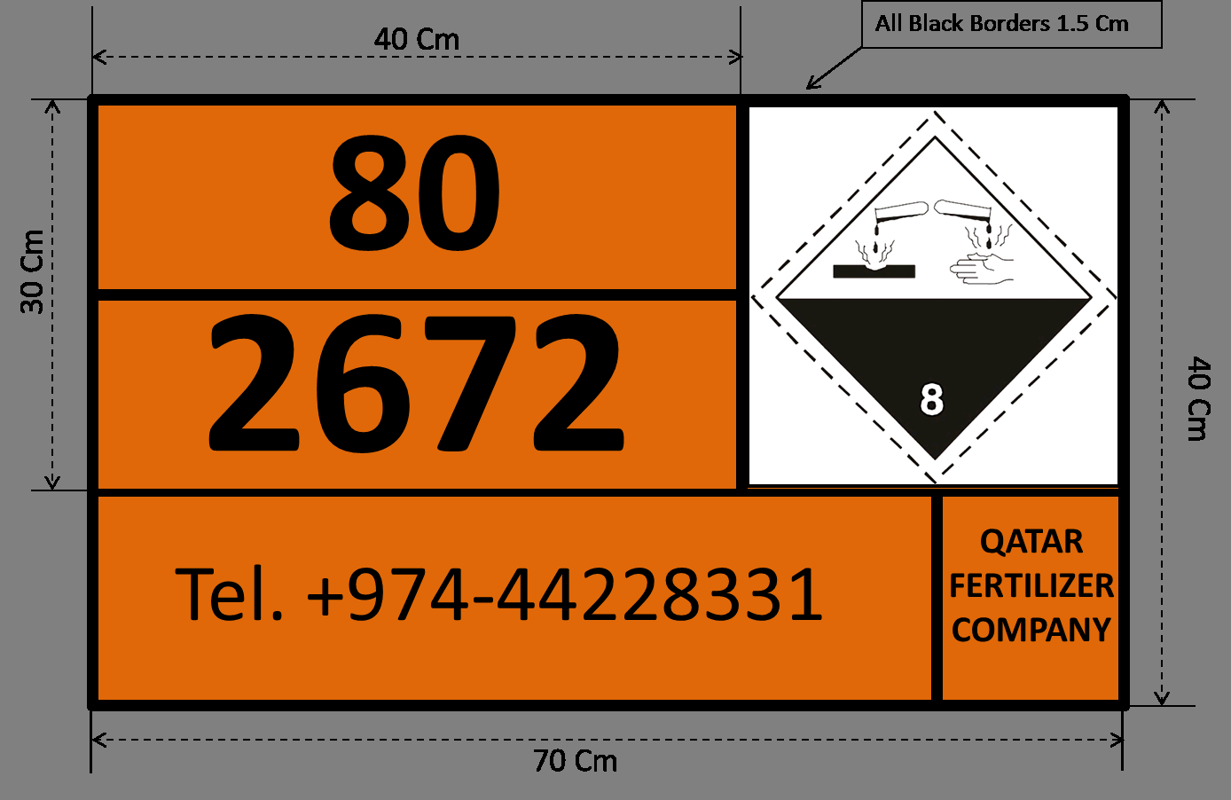

Slide 10
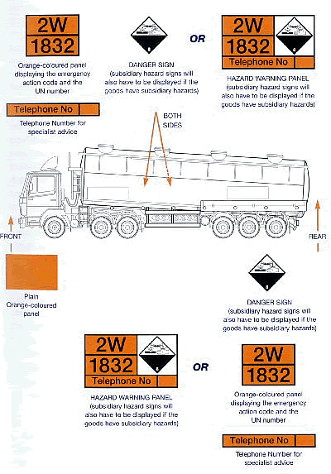

Slide 11
Implementation of ADR requirements
Tank Marking and Labelling
Periodic Testing and Certification
DG in Tanks: marking of both vehicle and tank
Orange plate placed in front & rear, hazard placards, etc.
Vehicle Safety Equipment
Mandatory equipment
Firefighting Equipment
8. Loading and Unloading
Loading
Unloading
Documentation, Vehicle and its load, driver, load distribution, protection of goods, etc.
Verify unloaded goods, check security load, re-secure unloaded DG.
Mixed Load Restriction
Mixed Packing Restriction

Slide 12
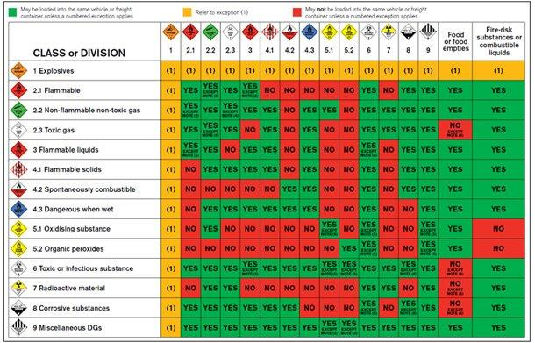

Slide 13
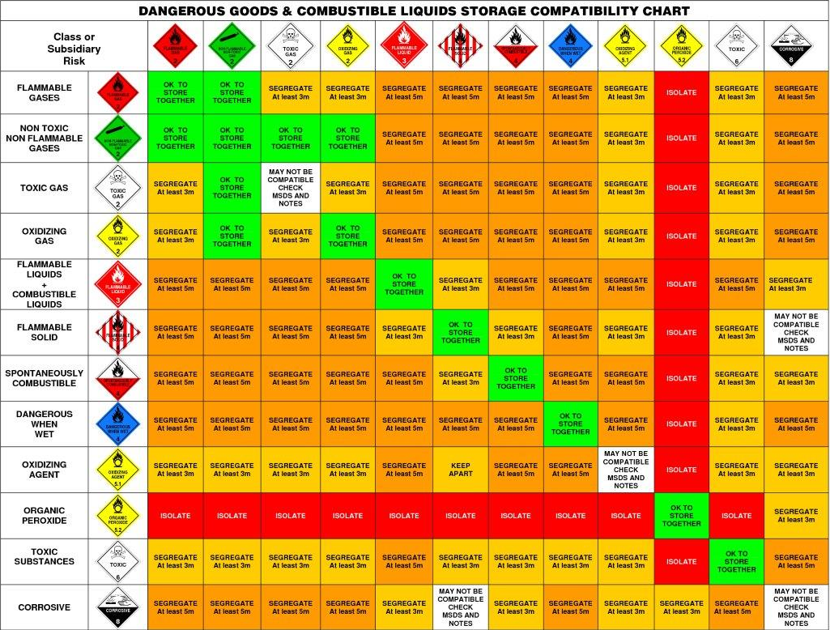

Slide 14
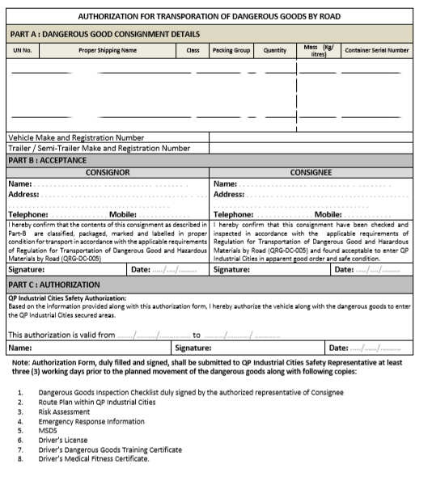
Implementation of ADR requirements
Documentation
Declaration
Transport Documentation
Packing Certificate
Transport Equipment Inspection and Certification
Regular/Periodic Inspection
Inspection in accordance with Qatar Traffic Legislation
Security Provisions
Declaration
Transport Documentation
Packing Certificate

Slide 15
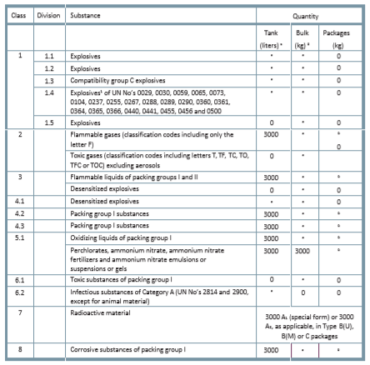
Implementation of ADR requirements
High consequence DG
Goods that have the potential for misuse that results in serious consequence such as mass causalities or mass destruction
Emergency Action
Procedures for : spills, fire/explosion/ traffic incident involving DG, loss of DG.
Authorization for Transportation of DG
Authorization of DG transportation form
Other documentation: DG inspection list, route plan, Risk assessment, ER info., SDS, etc.

Slide 16
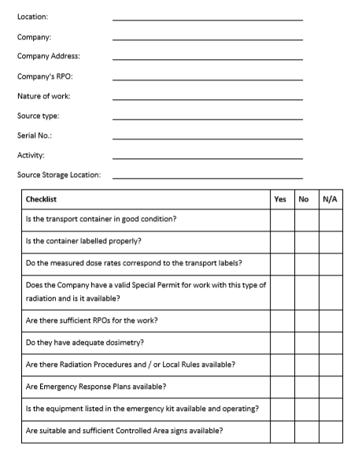
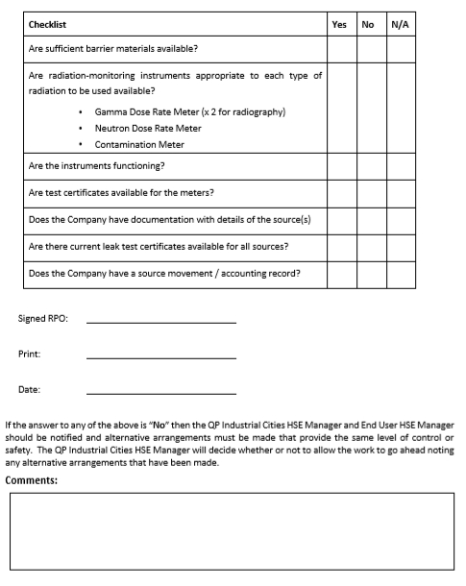
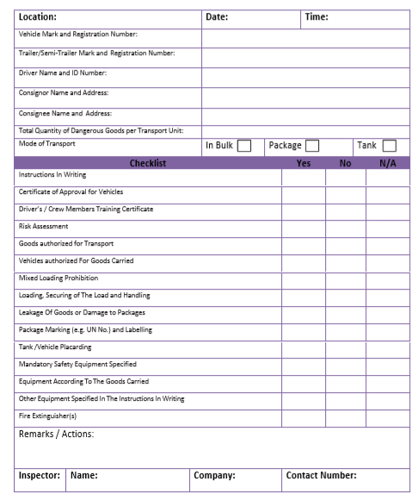
Implementation of ADR requirements
Enforcement and Inspection

Slide 17
THANK YOU

Slide 18
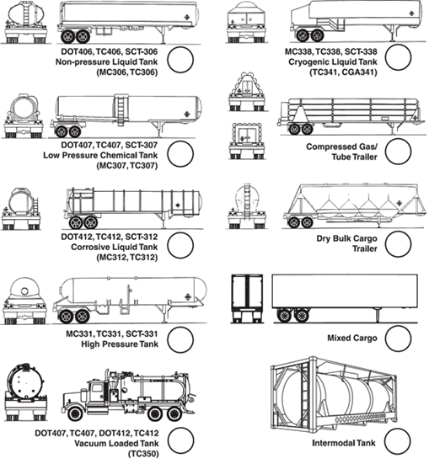

Slide 20
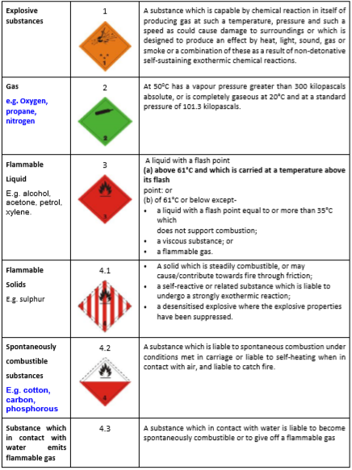
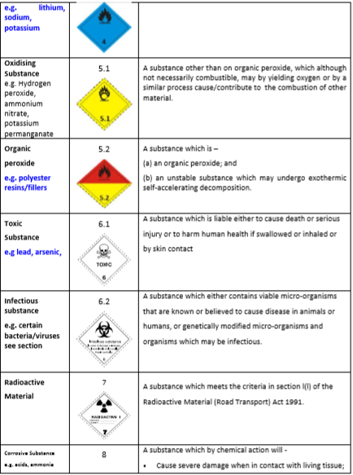
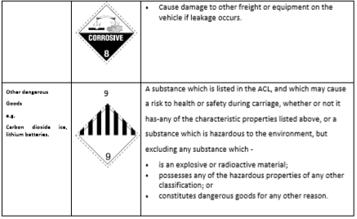

Slide 21
